Slide 1
HR ATTRITION REPORT
MESHACH ABAIDOO QUANSAH

Slide 2
INTRODUCTION
Hello And Welcome. In Today’s Presentation, I Am Excited To Take You Through This HR Attrition Dataset.
I Am Really Excited To Be Doing This Presentation As It Has Given Me The Opportunity To Dive Into, And Gain Insightful Information About This Special Project.

Slide 3
PROCESS
I am excited to state that, I took the necessary process in ensuring that this project has passed through the necessary steps and procedure before finally arriving at the final result.
Firstly, I got this dataset from Kaggle and downloaded it.
Secondly, I extracted the file and named it HR attrition data analysis on my computer.
I then opened power Bi to start work. So I exported the Excel file from my desktop unto Power BI.
After importing the file, I had the option to choose between Load or transform. I transform to transform and do so data cleaning since I already studied the data in excel and realized quiet a number of data cleaning had to be done.
The First thing I then did was to look for null values and empty cells which I worked on removing with power BI’s power query.
I then checked for duplicates.
I then moved on to checking each row and column for any wrong spellings or anomalies needed for correction.

Slide 4
PROCESS
I further decided to create some additional or new columns for my data sets to make reading into my data easy to understand.
Firstly, I created a new column and named it distance. This was intended to help read meaning into the distance from home column in the original data set. What I did was group the distance from home column into far(11-20), very far(21 and above) and short distance(<10).
Secondly, I created a column called Working Year group from the original total working years column such that, every working year from 0-10 years are grouped as such. Then those with 11-20 years also grouped, then 21-30 years and finally, 31 and above also grouped as one.
Thirdly, I had to create another column and named it satisfaction level from the original job satisfaction level and grouped them into High(3), Very High(4), Low(2) and Very Low(1).
Lastly, I had to create another column and named it age bracket to properly group the ages. So I grouped them into 4 sections. Those between (18-25years), (26-35years), (36-45years) and (46-60years)

Slide 5
OBJECTIVES
To uncover valuable and unexpected hidden insights from the data, answering business questions and providing strategic recommendations

Slide 6
BUSINESS QUESTIONS/KPIS
Find attrition by distance from Work
What is the attrition by working year group?
Calculate the total attrition by gender
Find the total attrition by satisfaction level.
Calculate the total attrition per department
What is the total attrition, total attrition rate and total employees?

Slide 7
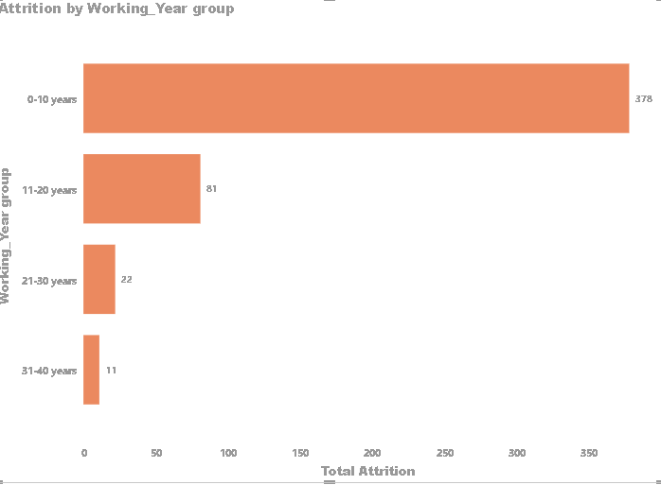
ATTRITION BY WORKING YEAR GROUP
At 378, 0-10 years had the highest Total Attrition and was 3,336.36% higher than 31-40 years, which had the lowest Total Attrition at 11. 0-10 years had the highest Total Attrition at 378, followed by 11-20 years, 21-30 years, and 31-40 years. Across all 4 Working_Year group, Total Attrition ranged from 11 to 378.

Slide 8
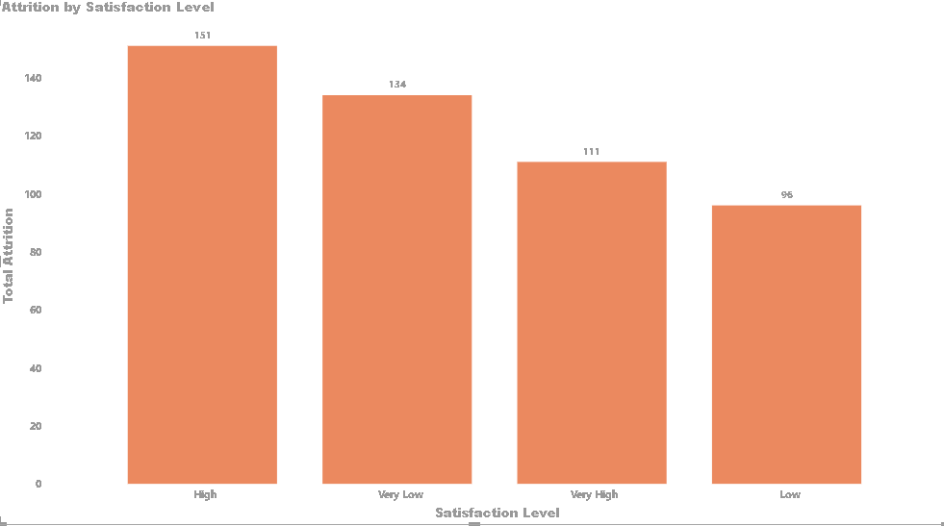
ATTRITION BY SATISFACTION LEVEL
At 151, High had the highest Total Attrition and was 57.29% higher than Low, which had the lowest Total Attrition at 96. High had the highest Total Attrition at 151, followed by Very Low, Very High, and Low. Across all 4 Satisfaction Level, Total Attrition ranged from 96 to 151.

Slide 9
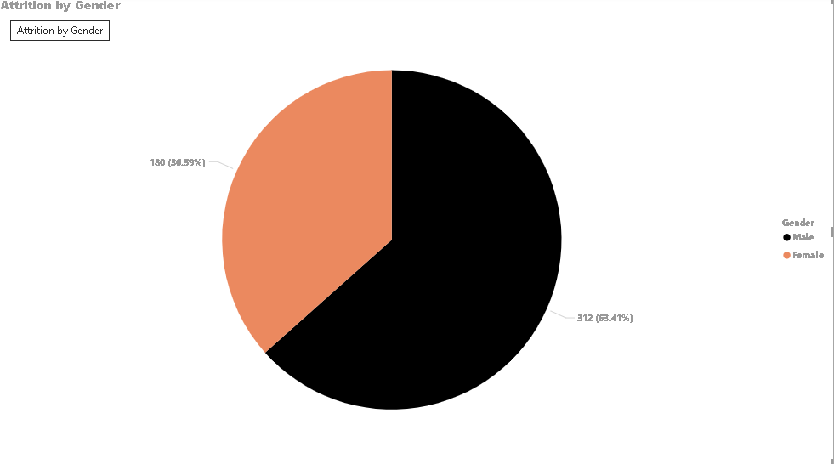
ATTRITION BY GENDER
Total Attrition for Male (312) was higher than Female (180).

Slide 10
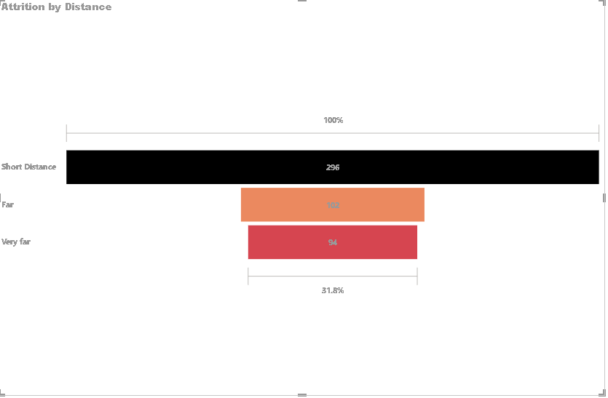
ATTRITION BY DISTANCE
Here, this project shows how the attrition rate for people living a short distance from work stands at the highest compared to workers living far and very far from the work station.

Slide 11
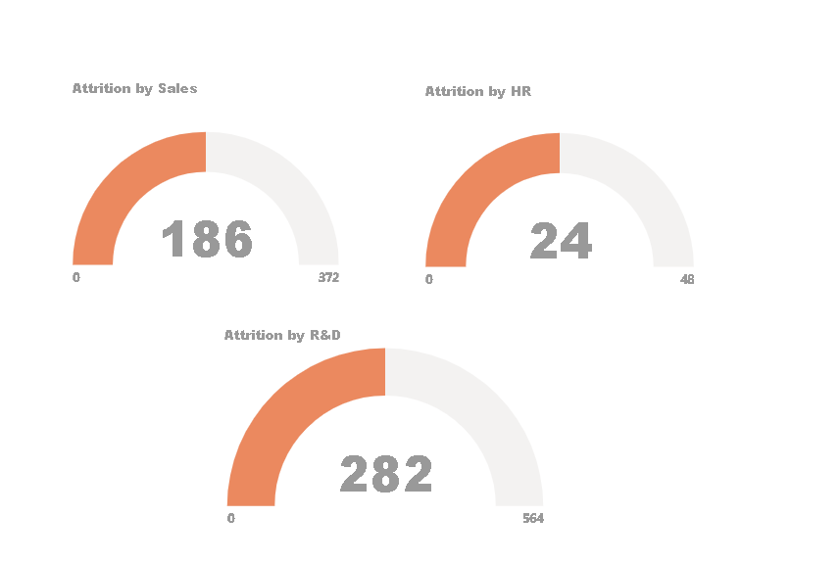
ATTRITION BY DEPARTMENTS
The following chart shows the attrition rate by departments.
Currently, we see that the attrition rate by R&D team stands at 282 out of the total attrition number which is 492, followed by Sales department at 186 and the lowest department HR at 24.

Slide 12
RECOMMENDATIONS
Firstly, the organization should focus on strategies to improve retention rates for employees in the 0-10 years experience bracket. This could involve:
Enhanced Onboarding and Training Programs
Career Development and Advancement Opportunities
Mentorship and Support Systems
Competitive Compensation and Benefits
Conduct a detailed analysis to understand the specific factors contributing to the high attrition among the "High" satisfaction level group. This could involve employee surveys, exit interviews, and focus groups.
Develop and implement targeted engagement strategies to better meet the needs of employees in the "High" satisfaction level. This may include personalized career development plans, increased recognition and rewards, or more flexible working arrangements.
Assess whether the compensation and benefits packages offered are aligned with the expectations and needs of the "High" satisfaction level employees. Competitive and equitable compensation can play a crucial role in improving retention.

Slide 13
RECOMMENDATIONS
Perform a thorough analysis to understand the specific reasons behind the higher attrition rates among male employees. This could involve reviewing exit interview data, conducting surveys, and analyzing employee feedback to identify any gender-specific issues or concerns.
Develop targeted engagement initiatives that cater to the needs and preferences of male employees. This might include creating more opportunities for professional growth, enhancing work-life balance programs, or implementing tailored recognition and reward systems.
Evaluate current workplace policies and organizational culture to ensure they support and retain employees of all genders equally. Address any potential biases or systemic issues that might contribute to the higher attrition rates among male employees.
Conduct a detailed analysis to understand why employees living close to the workplace are leaving at higher rates. Possible factors could include job satisfaction, work environment, or personal circumstances that may not be immediately apparent. Surveys and exit interviews can provide valuable insights.
Examine the working conditions and organizational culture to determine if there are factors specific to employees living close to work that might be contributing to higher attrition. For instance, if there are differences in work roles, expectations, or team dynamics for those living nearby, addressing these issues may improve retention.
Develop and implement targeted engagement and satisfaction strategies for employees living close to the workplace. This might include initiatives such as flexible work hours, additional career development opportunities, or enhanced recognition programs.

Slide 14
RECOMMENDATIONS
Given that the R&D team has the highest attrition rate, it is crucial to conduct a comprehensive review of this department. Investigate the specific factors contributing to high attrition, such as workload, job satisfaction, career development opportunities, or team dynamics. Surveys and exit interviews can provide valuable insights into the underlying issues.
Based on the findings from the investigation, implement targeted strategies to improve engagement and satisfaction within the R&D team. This could include providing additional training, improving project management practices, offering career development programs, or increasing recognition and rewards.
With the Sales department experiencing the second-highest attrition rate, it is important to evaluate current strategies and support systems in place. Address potential factors such as sales targets, compensation structures, and team morale to enhance employee retention in this department.
The HR department has the lowest attrition rate, indicating effective retention strategies. Continue to support and refine these practices, ensuring that HR’s approach to employee engagement, satisfaction, and career development remains strong and adaptive to any emerging needs.
Develop and implement tailored retention plans for each department based on their specific attrition rates and needs. Regularly monitor the effectiveness of these plans and make adjustments as necessary to address any emerging trends or challenges.
Foster a culture of collaboration and knowledge sharing between departments to leverage successful retention strategies and practices. This can help in identifying best practices and implementing them across the organization.

Slide 15
THANK YOU
MESHACH ABAIDOO QUANSAH

